Slide 1
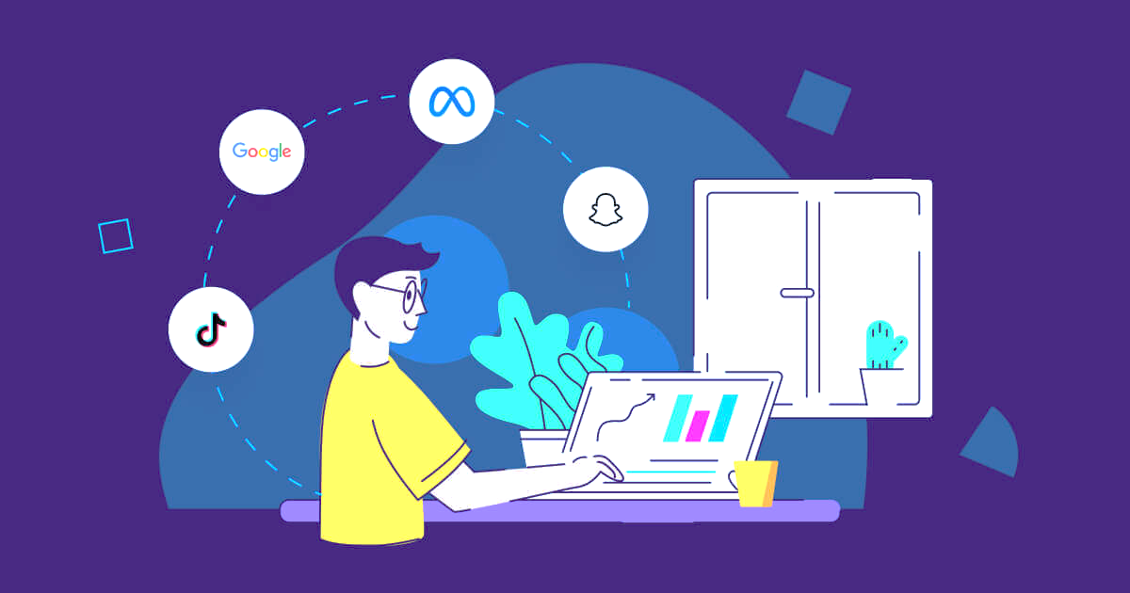
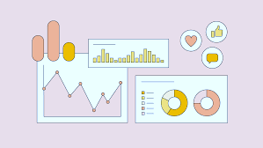
SOCIAL MEDIA ANALYSIS
Submitted By:
Nikita Singh Raghav

Slide 2
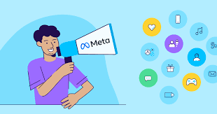
ABOUT META
Meta Platforms, Inc. doing businesses as Meta and formerly named Facebook, Inc. The company owns and operates Facebook, Instagram, Threads and WhatsApp among other products and services.

Slide 3
AGENDA
01
02
03
04
05
Problem Statement
Data Description
Key Metrics and Visualizations
Targeted marketing strategies
Conclusion

Slide 4
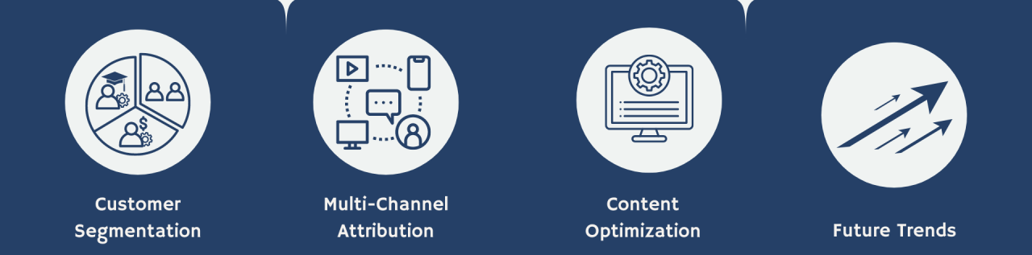
PROBLEM STATEMENT
You are hired as a data analyst at Meta and asked to collaborate with Marketing team. Marketing teams wants to leverage Instagram's user data to develop targeted marketing strategies that will increase user engagement, retention, and acquisition. Provide insights and recommendations to address the following objectives

Slide 5
DATA DESCRIPTION
The dataset contains information 7 tables. Below is an overview of the dataset:
Users Table : information about users registered on the platform
Photos Table: information about the photos uploaded by users.
Comments Table: Stores all comments made by users on photos.
Likes Table: Tracks which users liked which photos.
Follows Table: Tracks user relationships (followers and followees).
Tags Table: Stores unique tags that are associated with photos.
Photo_Tags Table: connects photos with tags.
comments_id : unique identifier for each comment
comment_text : text content of a given comment
user_id : unique identifier for each user
photo_id : unique identifier for each photo
created_at : date of interaction in the form like, photos, tags
follower_id : user_id of the follower for a certain user
followee_id : user_id of followee for a certain user
tag_id : unique identifier for each tag
image_url : link to the image posted on the platform
username : username chosen by the user

Slide 6
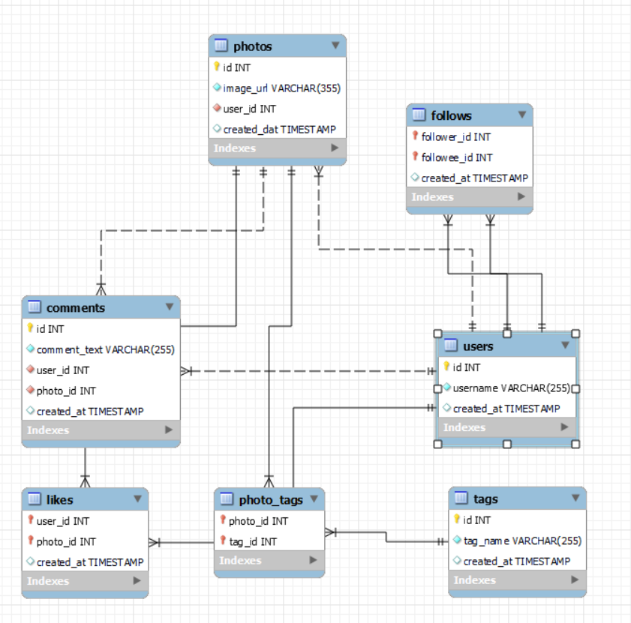
DATABASE SCHEMA

Slide 7
KEY METRICS AND VISUALIZATION
1. USERS
Activity Wise
Joining Year Wise
Inactive Users: 26
Active Users: 74
2016: 65
2017: 35
The 26 inactive users highlight a potential retention issue.
The drop in new users in 2017, the priority should be on boosting user acquisition

Slide 8
2. POSTS- NO. OF PHOTOS POSTED
High Inactivity: 26 users have posted 0 photos, highlighting a large portion of inactive users
Few Highly Active Users: Only 6 users posted more than 6 photos and 1 user reaching 12 posts, revealing a lack of highly active users on the platform.

Slide 9
3. TAGS
In total there are 21 different tags used by the users.
High Inactivity with Tags
31 users have used 0 tags
Indicating a significant portion of users who do not engage with tags at all.
Few Highly Active Tag Users
Only a small number of users have used more than 6 tags
1 user using up to 15 tags
It demonstrate that few users are highly engaged with tagging.

Slide 10
Tag Categorization
For Better understanding, I have categorized tags into 8 different Categories:
CATEGORY | TAGS
Joy-Emotions | Happy, Smile
Aesthetics | Stunning, Dreamy
Food | Delicious, Food, Foodie
Party & Fun | Concert, Party, Drunk, Lol, Fun
Beauty | Beauty, Hair
Landscape | Landscape, Sunrise, Sunset, Beach
Fashion | Fashion, Style
Photography | Photography

Slide 11
CONTENT-CENTRIC ANALYSIS
Most Liked Categories- Party & Fun, Landscape, Joy-Emotions represents users that are drawn to energetic, visually appealing, and emotionally uplifting content
While Least Liked categories like- Photography, Aesthetics have low overall engagement, they may still resonate with a niche audience.

Slide 12
USER-CENTRIC ANALYSIS
PHOTOGRAPHY is the only tag category whose people are using it but not engaging enough to make it to anyone’s top 3 most liked Tags Category.
Nearly every user who engages with below tags including them in their top 3 most liked categories - Party & Fun, Landscape, Joy-Emotions

Slide 13
How User centric analysis and Content centric analysis will help in developing strategies
CONTENT-CENTRIC ANALYSIS
USER-CENTRIC ANALYSIS
This insight is more valuable for developing personalized marketing strategies
It is more actionable for increasing user engagement, retention, and acquisition, as it provides insights into personalized content users are invested in.
This insight is more useful for optimizing content creation and general platform engagement
It can guide content strategies for wider audience appeal, but not as targeted or effective for long-term retention and acquisition.

Slide 14
4. ACTIVITY
In Active | 23 Users
Moderate Activity | 47 Users
Highly Active | 13 Users
Primary Focus: Retention
The 23 inactive users should be re-engaged to reduce churn and improve platform activity
Secondary Focus: Engagement
To increase the activity levels of moderate active users

Slide 15
5. ENGAGEMENT
In Active | 26 Users
Moderate Activity | 58 Users
Highly Active | 16 Users
Primary Focus: Retention
It is necessary to address the significant number of users with zero engagement.
Secondary Focus: Engagement
To increase the activity levels of moderately engaged users

Slide 16
ENGAGEMENT BASED ON JOINING YEAR AND FOLLOWER COUNT
Newer users(2017) are more actively contributing content
Users from the 2017 cohort with 76 followers have the highest average engagement
2017 cohort with 77 followers shows higher average posting activity

Slide 17
POTENTIAL INFLUENCERS OR BRAND AMBASSADOR
ID | USERNAME | FOLLOWER | TOTAL LIKES | AVG ENGAGEMENT RATE
23 | Eveline95 | 77 | 749 | 9.8
59 | Cesar93 | 77 | 646 | 8.4
86 | Delfina_VonRueden68 | 77 | 558 | 7.2
88 | Clint27 | 77 | 660 | 8.6
Users with a High Follower Count and High Engagement are prime candidates.
Users who have Consistency in Engagement across multiple posts as opposed to one-time viral activity.
We should focus on Users with Balanced Engagement, as these users are more likely to influence their network and drive engagement for Instagram initiatives.

Slide 18
CORRELATION BETWEEN UPLOADS & ENGAGEMENT
As the number of photo uploads increases, so does the average total engagement showing positive correlation between the number of photo uploads and total engagement
Engagement growth slows between 10 and 11 uploads, indicating that quantity alone doesn’t guarantee higher engagement; quality content is essential.

Slide 19
USER SEGMENTATION
To Develop Marketing Strategies, understanding User both on their engagement and activity level is important. Thus Users are segmented into different categories based on the following categories
Category : Activity Status
No Activity: activity = 0
High Activity: activity >= 250
Low Activity: activity < 150
Moderate Activity: activity BETWEEN 150 AND 250
Category: Engagement Status
No Engagement: engagement= 0
High Engagement: engagement>= 300
Low Engagement: engagement< 200
Moderate Engagement: engagement BETWEEN 200 AND 300

Slide 21
MARKETING STRATEGIES
User Retention
User Acquisition
User Engagement
MAIN CONCERN:
Users With No Activity
Users With No Engagement
Users With Neither Activity Nor Engagement
MAIN CONCERN:
User decline since 2017.
Attracting new users.
Varied engagement levels: high vs. low engagement.
MAIN CONCERN:
40 of 74 active users post only 1-3 photos.
Need to boost engagement and activity among moderate users.
31 users lack tags, limiting discoverability.

Slide 22




USER RETENTION
Re-Engagement Campaigns
Suggest targeted posts, hashtags, and users to follow based on past engagement, encouraging reconnection with the platform.
Exclusive Incentives
Offer limited-time discounts on premium features to encourage users to return to the platform
Content Discovery Aids
Create brief tutorials highlighting new features and trends to help users navigate the platform after a break.
Feedbacks and Surveys
Send brief surveys to inactive users to understand their disengagement, offering incentives for insights to inform retention strategies.

Slide 23
USER ACQUISITION
Tailor Onboarding Experience
Design a tailored onboarding for new users that highlights features, popular tags, and success stories.
Tag Education Campaigns
Launch initiatives to educate users on the benefits of tags through blog posts and video tutorials.
Referral Incentives
Launch a referral program rewarding users with discounts or exclusive content for bringing in new members.
Engagement Boosters
Send personalized emails highlighting new features, trending content, and tutorials to boost engagement.

Slide 24
USER ENGAGEMENT
User Recognition
Introduce awards like ‘User of the Month’ and hold photo contests to boost engagement.
Educational Resources
Offer tutorials and webinars on maximizing engagement and using platform features effectively.
Community Initiatives
Create forums and social events, and launch an ambassador program to promote the platform.
Influencer Collaborations
Partner with engaged influencers to attract new users and enhance current user participation.

Slide 25

CONCLUSION
User Acquisition Efforts: Leverage influencer partnerships and ambassador programs to attract new users, while implementing educational initiatives to help them effectively engage with the platform.
User Retention Strategies: Use personalized content recommendations, exclusive offers, and feedback mechanisms to retain users and address inactivity.
User Engagement Initiatives: Focus on re-engagement campaigns, tag usage promotions, and community-building activities to encourage inactive and moderately active users to enhance their overall experience.

Slide 26


